Slide 1

Customer Shopping Behavior Analysis
Uncovering insights from 3,900 purchases to guide strategic business decisions through data-driven analysis of spending patterns, customer segments, and product preferences.

Slide 2
DATASET OVERVIEW
Understanding Our Data Foundation
3.9K
18
50
Total Purchases
Data Points
Locations
Transactions analyzed across all categories
Features per customer transaction
Geographic coverage across regions
Key Features Tracked
Customer demographics (Age, Gender, Location, Subscription Status)
Purchase details (Item, Category, Amount, Season, Size, Color)
Shopping behavior (Discounts, Promo Codes, Previous Purchases, Review Ratings)

Slide 3

Data Preparation & Cleaning
01
Data Loading & Exploration
Imported dataset using pandas and performed initial structure analysis with summary statistics
02
Missing Data Handling
Imputed 37 missing Review Rating values using median rating by product category
03
Feature Engineering
Created age_group bins and purchase_frequency_days columns for deeper analysis
04
Database Integration
Connected to PostgreSQL and loaded cleaned data for SQL-based business analysis

Slide 4

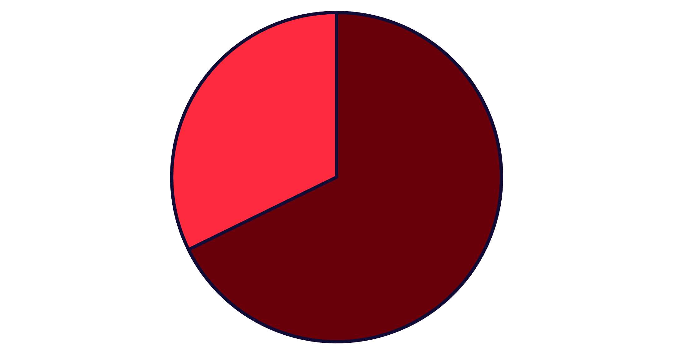
SQL ANALYSIS
Revenue Insights by Gender
Male Customers Drive Revenue
Male customers generate 68% of total revenue ($157,890) compared to female customers ($75,191). This significant disparity suggests opportunities for targeted marketing campaigns to better engage female shoppers and balance revenue streams.
Male
Female

Slide 5



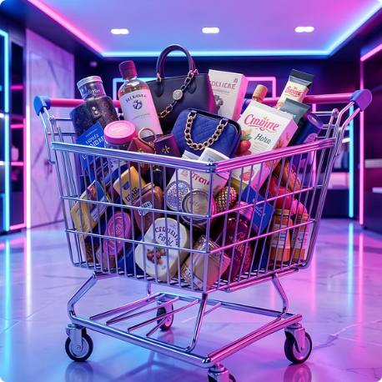
Product Performance & Customer Behavior
Top-Rated Products
Discount-Dependent Items
Shipping Preferences
High-Spending Discount Users
Gloves (3.86), Sandals (3.84), and Boots (3.82) lead in customer satisfaction ratings
Express shipping users spend $60.48 on average vs. $58.46 for standard shipping
Hat (50%), Sneakers (49.66%), and Coat (49.07%) show highest discount usage rates
839 customers used discounts but still spent above the $59.76 average purchase amount

Slide 6
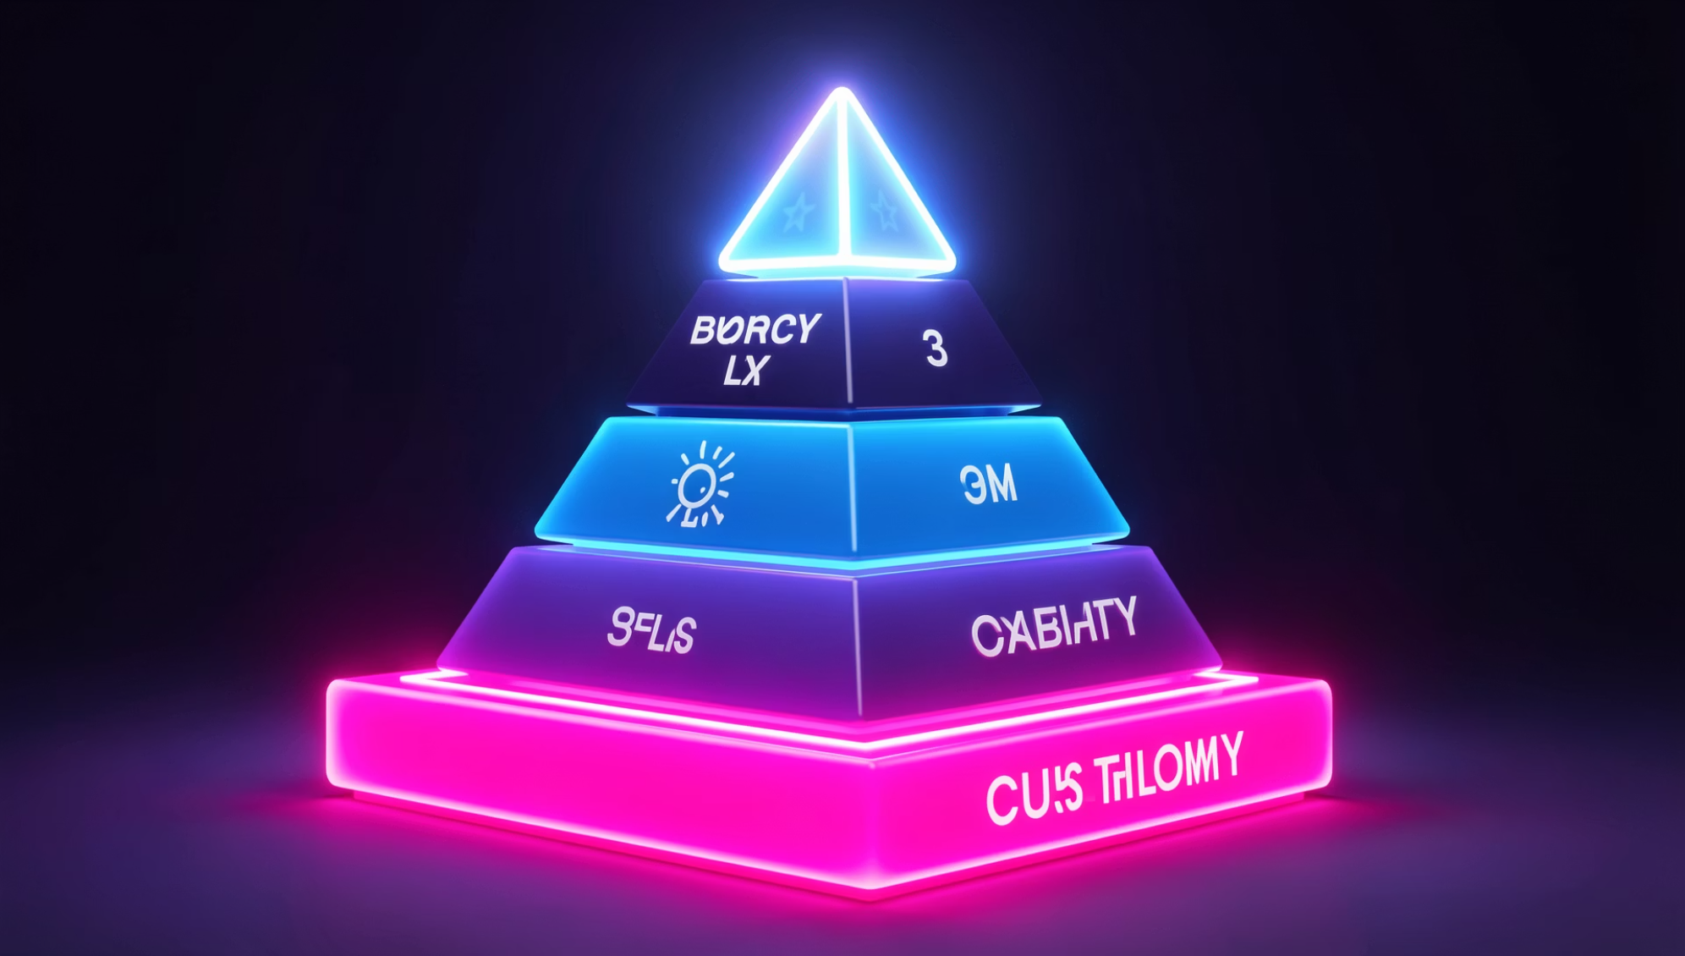
SEGMENTATION
Customer Loyalty Breakdown
Three Distinct Segments
Our customer base reveals a strong foundation of repeat buyers, with opportunities to convert new customers into loyal advocates.
Loyal Customers
Returning Buyers
New Customers
3,116 customers with consistent purchase history
701 customers showing repeat interest
83 customers just starting their journey

Slide 7
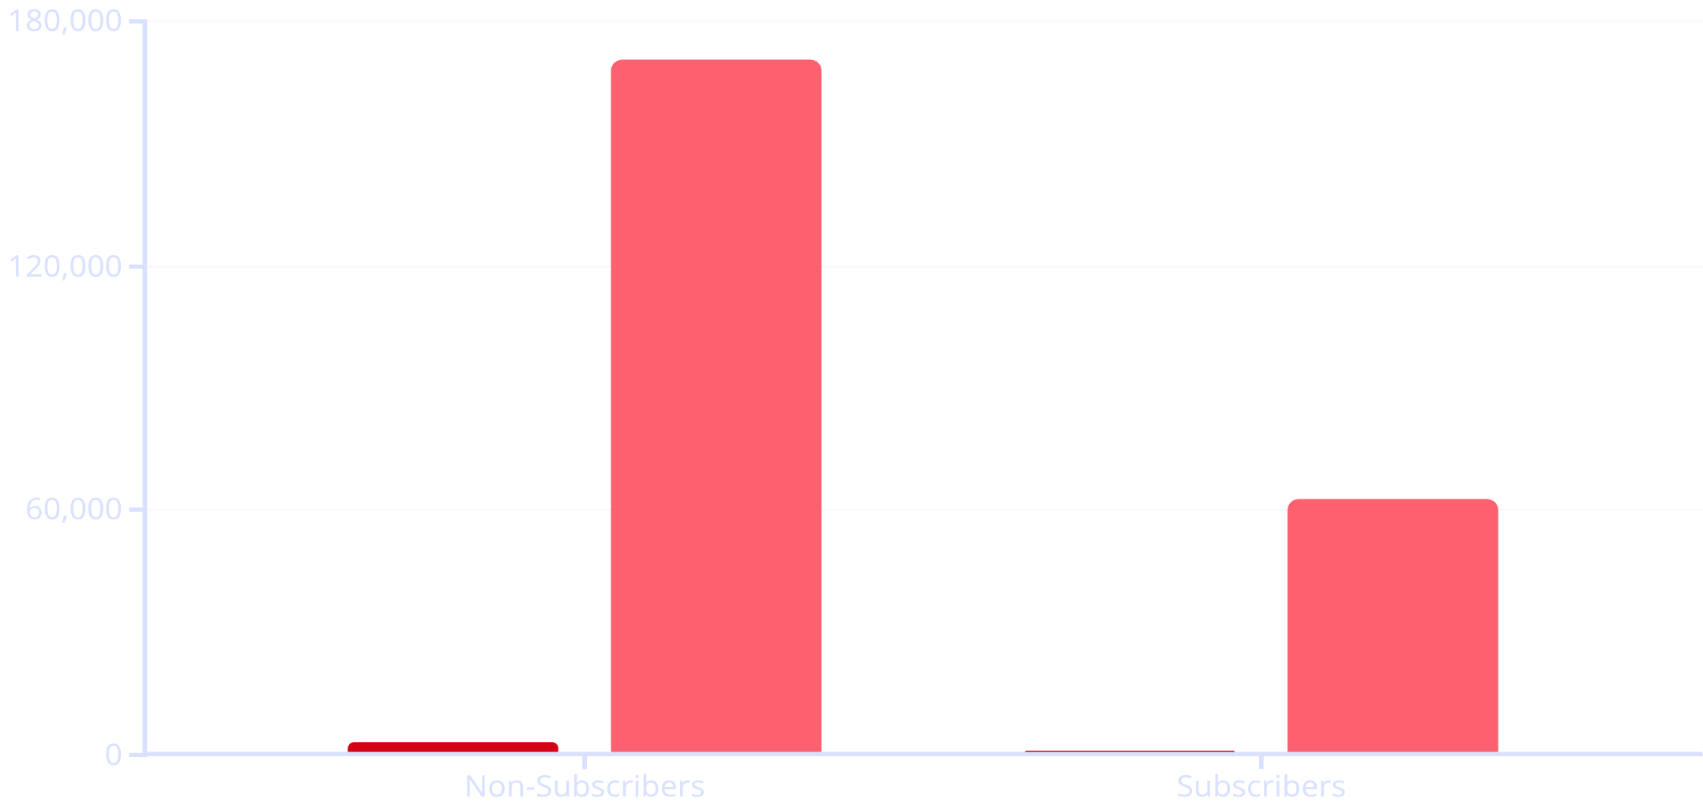
Subscription Status Analysis
Subscription Opportunity
Only 27% of customers are subscribers, yet they maintain similar average spend ($59.49 vs. $59.87). With 958 repeat buyers (>5 purchases) not subscribed, there's significant potential to convert loyal customers into subscribers.
Customers
Revenue

Slide 8
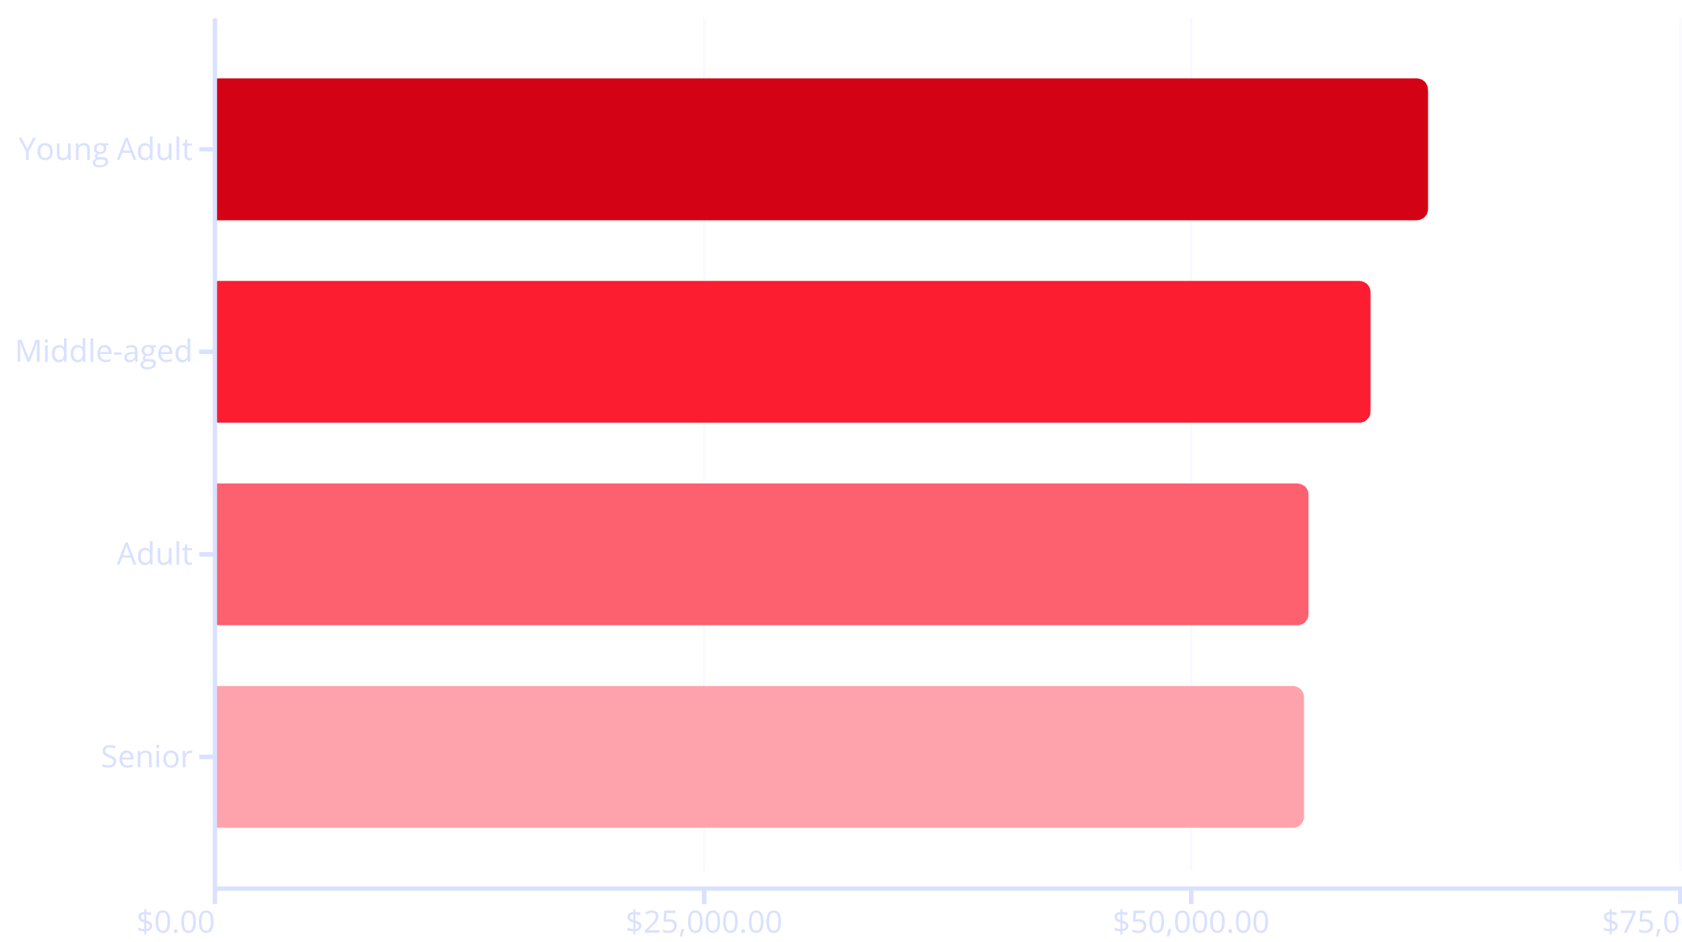
Revenue Distribution by Age Group
Balanced Demographics
Revenue is relatively balanced across age groups, with Young Adults leading at $62,143. This even distribution suggests broad market appeal and opportunities for age-specific campaigns.

Slide 9
CATEGORY PERFORMANCE
Top Products by Category
1
2
3
4
Accessories
Clothing
Footwear
Outerwear
Jewelry (171 orders), Sunglasses (161), Belt (161)
Blouse (171 orders), Pants (171), Shirt (169)
Sandals (160 orders), Shoes (150), Sneakers (145)
Jacket (163 orders), Coat (161)
Clothing dominates with the highest order volumes, while Accessories and Outerwear show strong consistent performance across top products.

Slide 10





Strategic Recommendations
Boost Subscriptions
Loyalty Programs
Review Discount Policy
Promote exclusive benefits to convert 958 repeat buyers into subscribers and increase the current 27% subscription rate
Reward repeat buyers to move 701 returning customers into the loyal segment of 3,116 customers
Balance sales boosts with margin control for high-discount items like Hats (50%) and Sneakers (49.66%)
Product Positioning
Targeted Marketing
Highlight top-rated products (Gloves 3.86, Sandals 3.84) and best-sellers in marketing campaigns
Focus on Young Adults ($62K revenue) and express-shipping users ($60.48 avg spend) for maximum ROI

